Slide 1
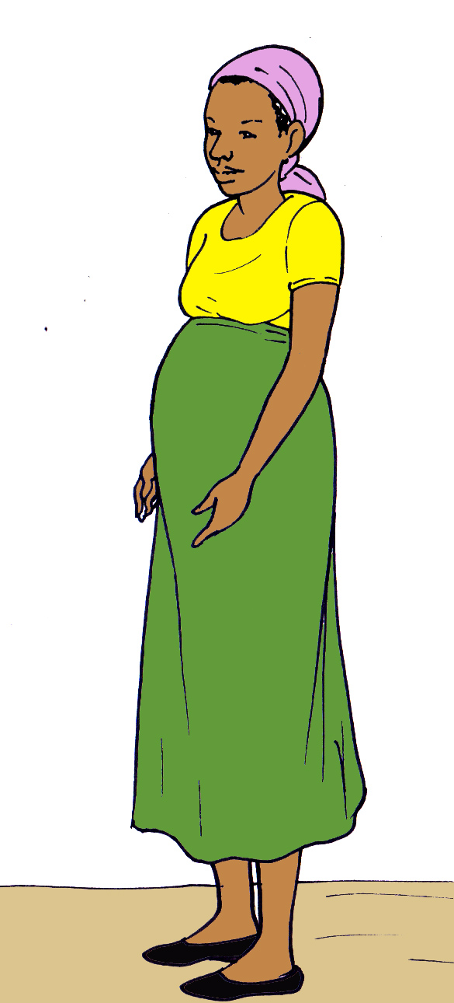
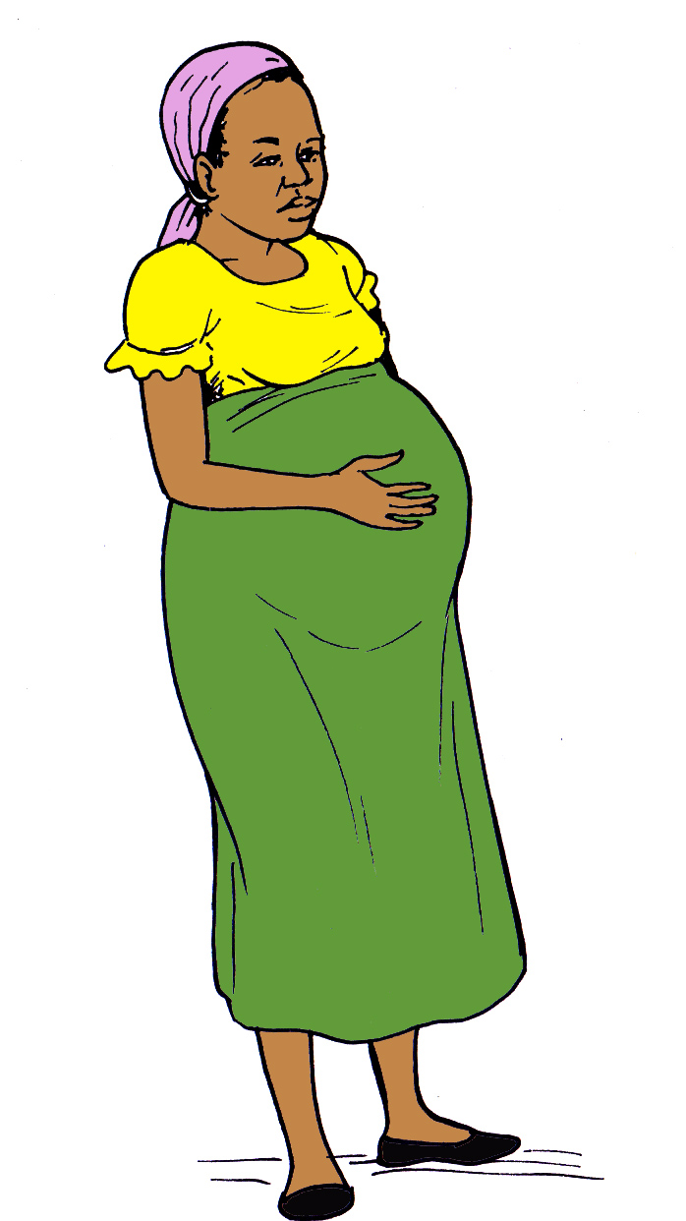
Guide to PRETERM Birth

Slide 2
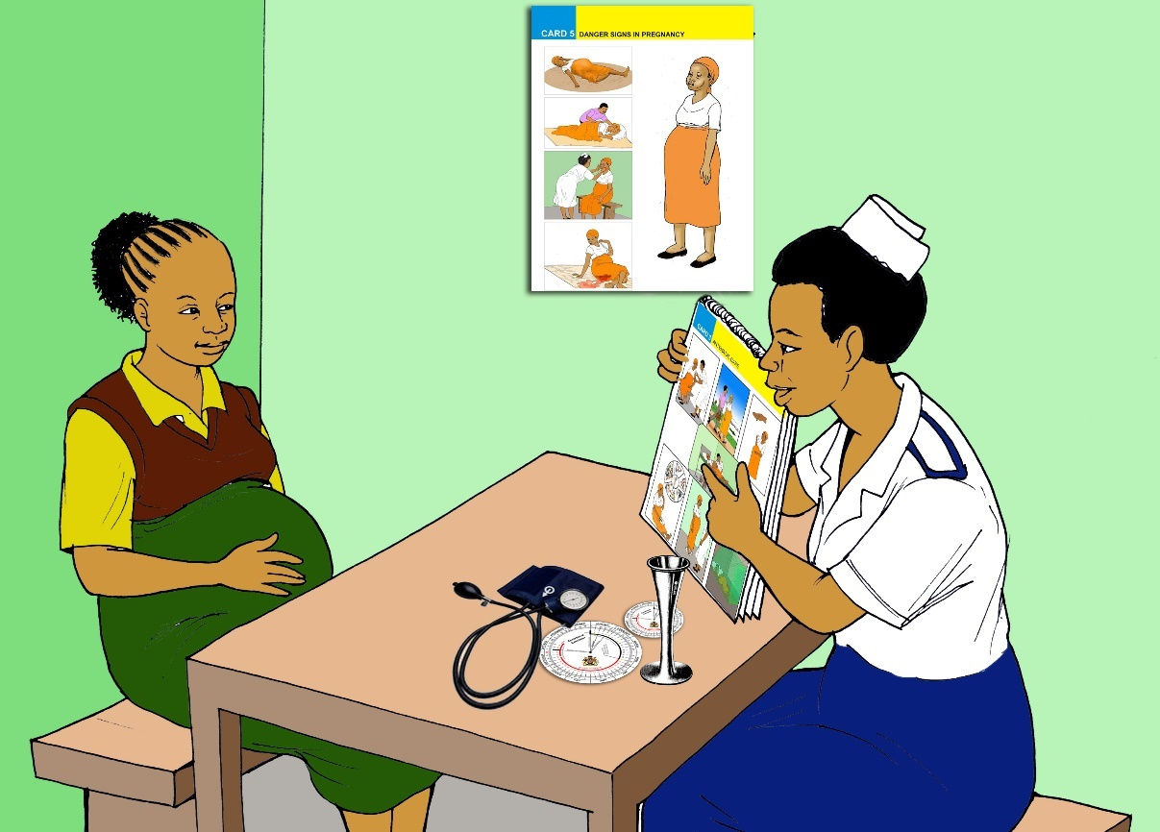
Using this manual
Define preterm delivery
Learn the factors that increase and decrease risk of preterm delivery
Know the symptoms of preterm delivery
Understand what to expect in the event of preterm labor and delivery

Slide 3
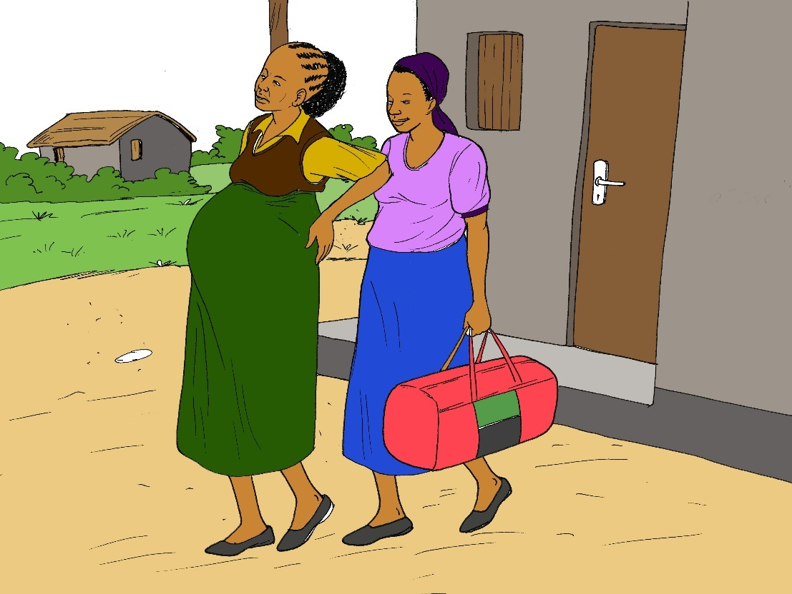
What is preterm delivery?
Pregnancy lasts 40 weeks
If your labor begins before the 37th week of pregnancy, you are in preterm labor
Preterm delivery is the most common cause of death in newborn babies
In Malawi, 1 in every 5 babies is born preterm

Slide 4
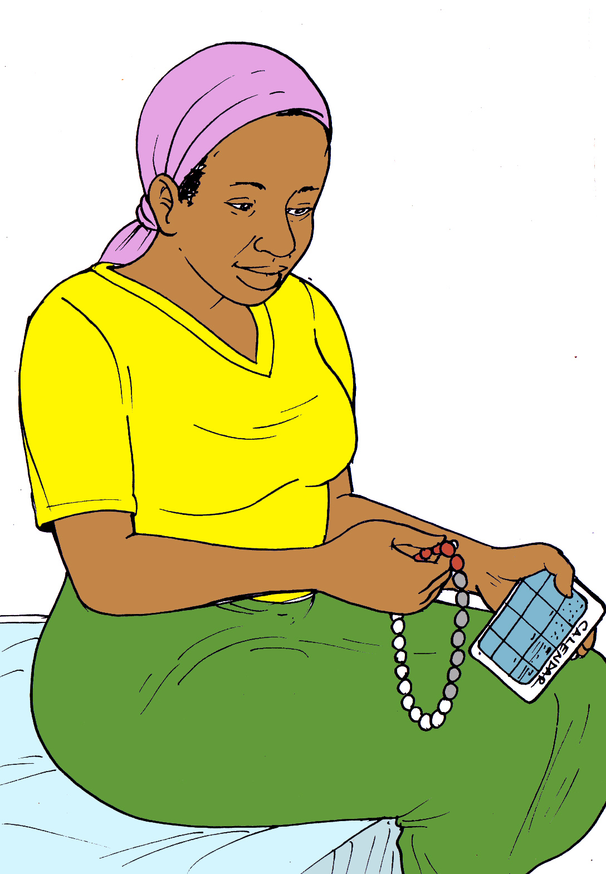
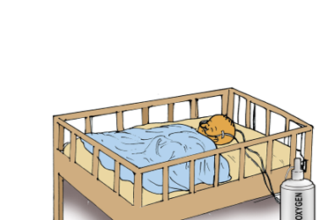
How do I know if my baby is preterm?
Keep track of your period using
A calendar
Beads
Your phone
Your health care provider will use the first day you bled to calculate your due date
A full term pregnancy is 40 weeks
If you have the baby more than one month before your due date, your baby is preterm

Slide 5
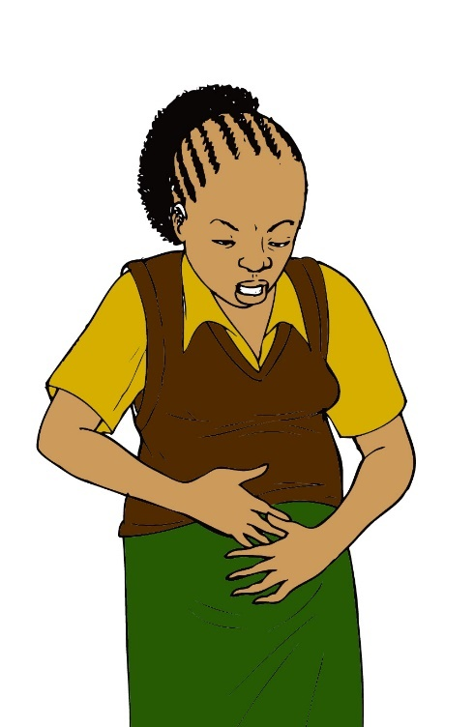
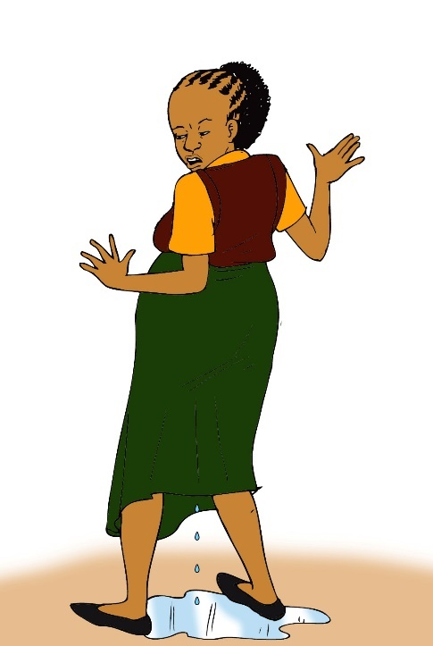
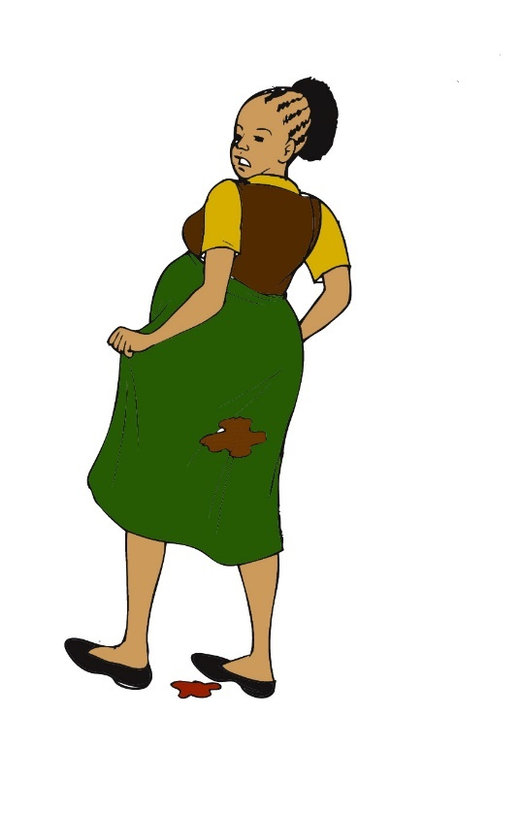
How do I know if I am in preterm labour?
One month or more before your due date, you have:
Regular painful contractions
Leaking of water from the vagina
Bleeding from the vagina

Slide 6
Why is preterm birth a problem?
Babies born too soon can have many problems
Difficulty breathing
Infections
Low blood sugar
Low body temperature
Seizures
Injury to brain

Slide 7
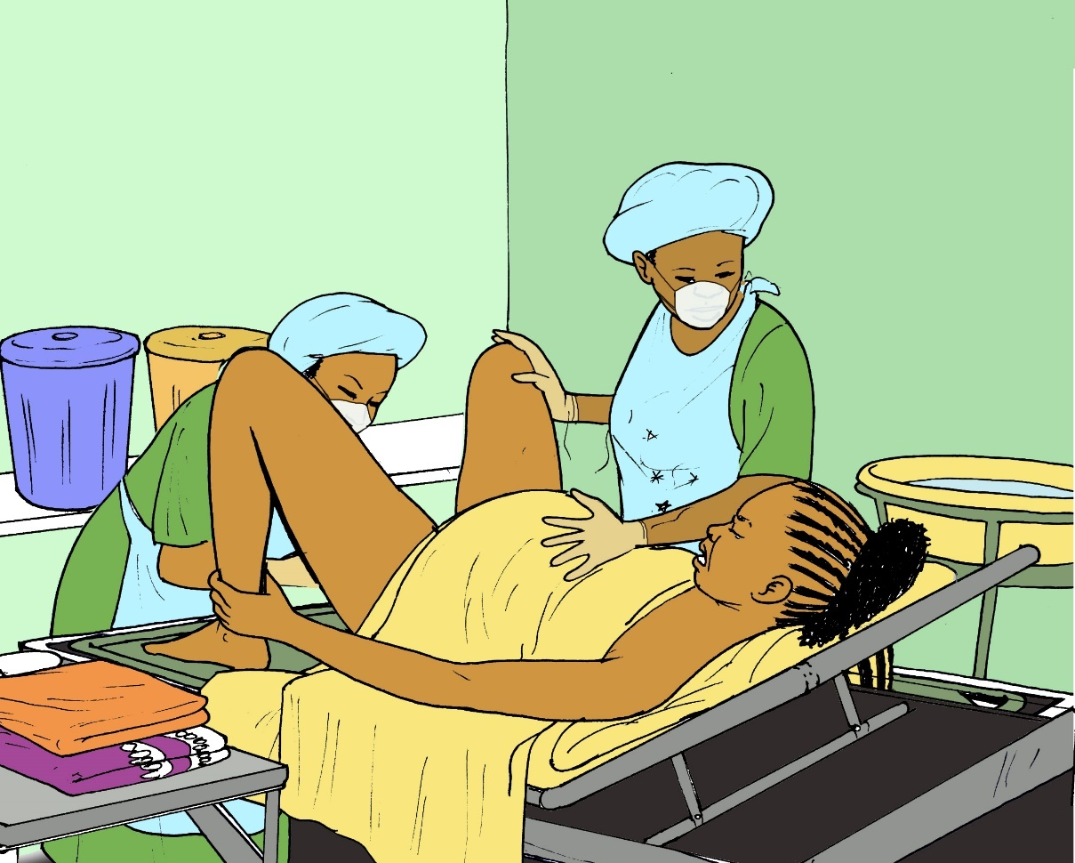
Factors that increase risk of preterm delivery
High blood pressure during pregnancy
Smoking during pregnancy
Intimate partner violence

Slide 8
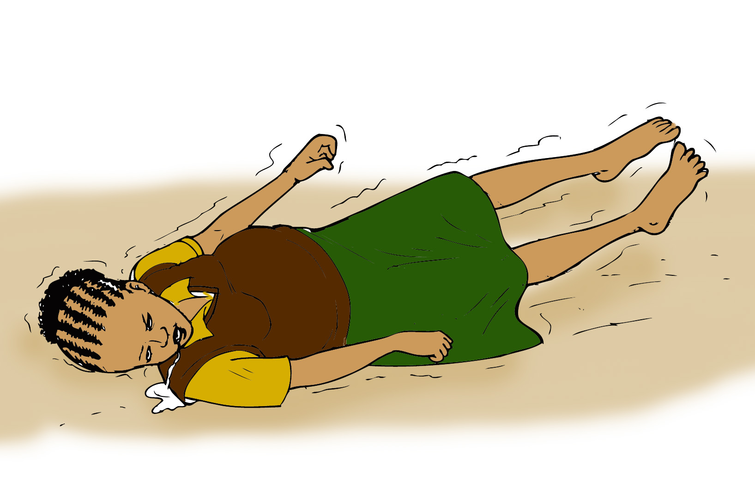
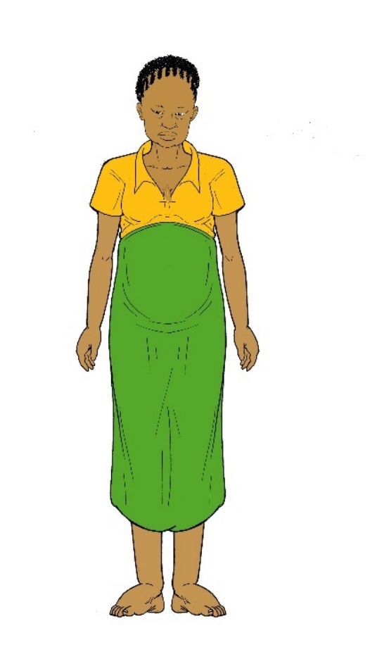

High blood pressure
Symptoms of high blood pressure include
Rapid weight gain
Abdominal pain
Severe headaches
Blurry vision
Swelling of the face, hands, or feet
Seizures
Swelling in face
Swelling in hands
Swelling in feet

Slide 9
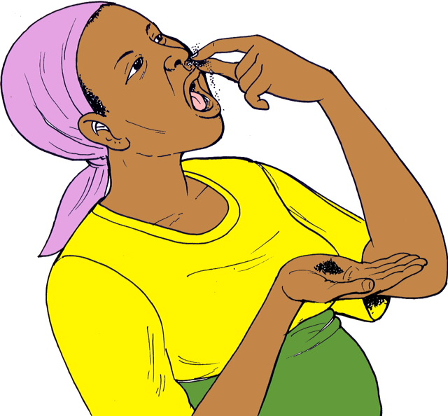
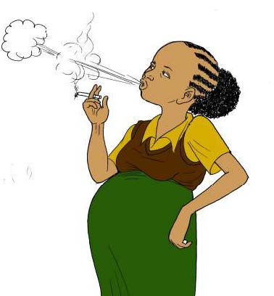
tobacco during pregnancy
Smoking or chewing tobacco leaves during pregnancy increases the chance of preterm labor

Slide 10

Intimate partner violence
Violence during pregnancy can result in preterm labor and even death of the baby
If your partner is hurting you, you should tell you health care provider so that they can help find a way to keep you safe

Slide 11
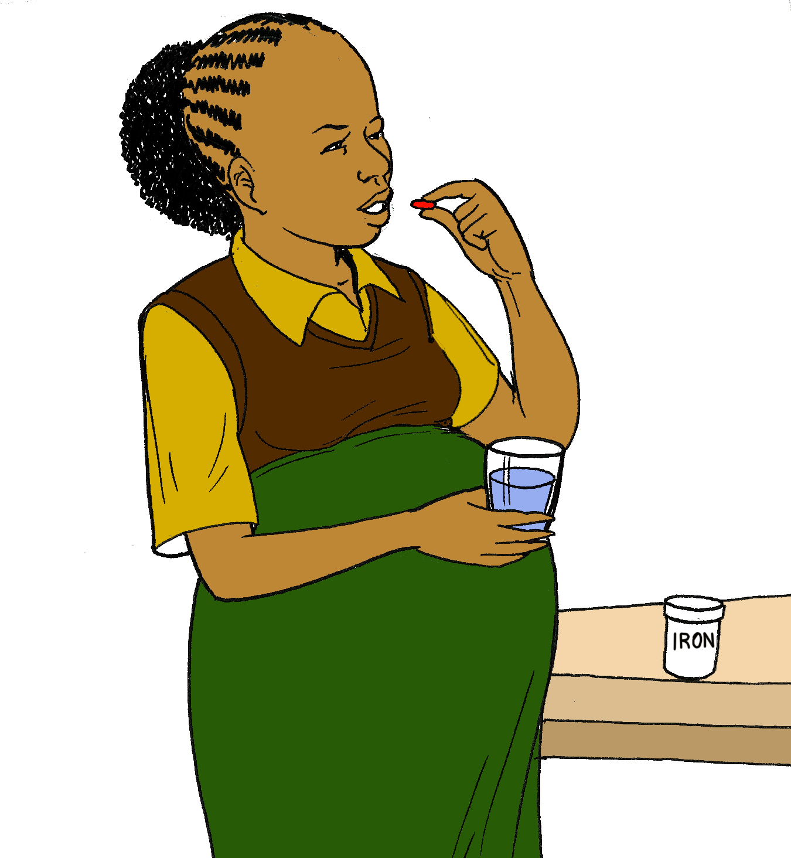
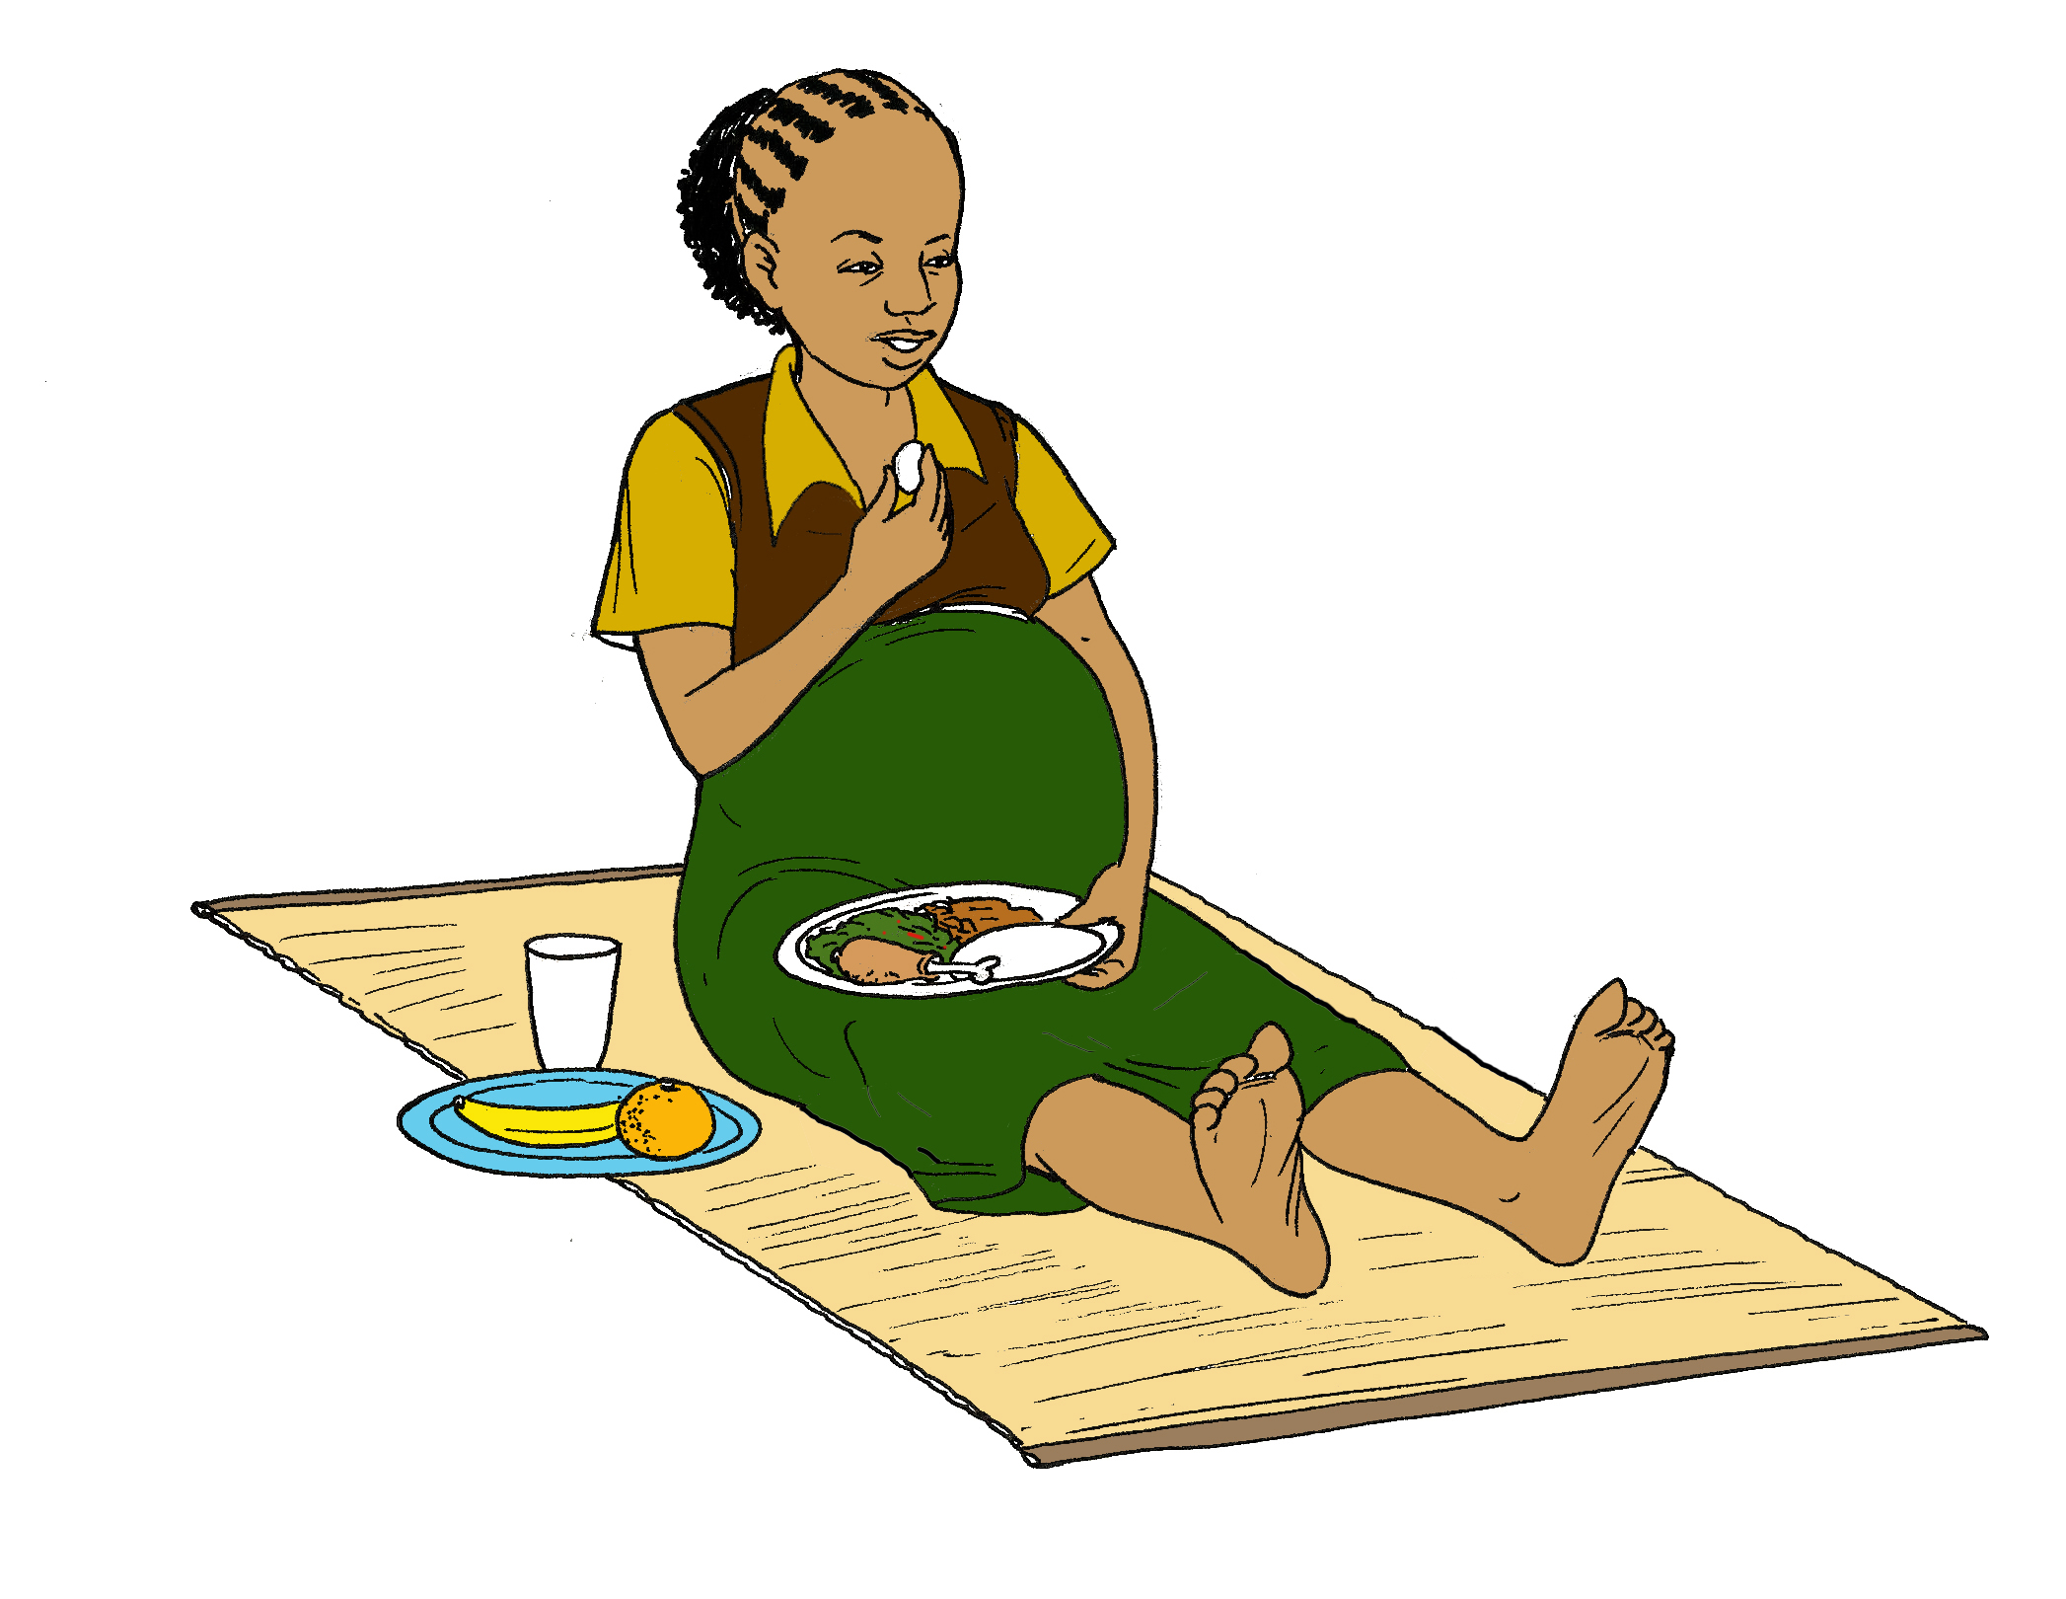
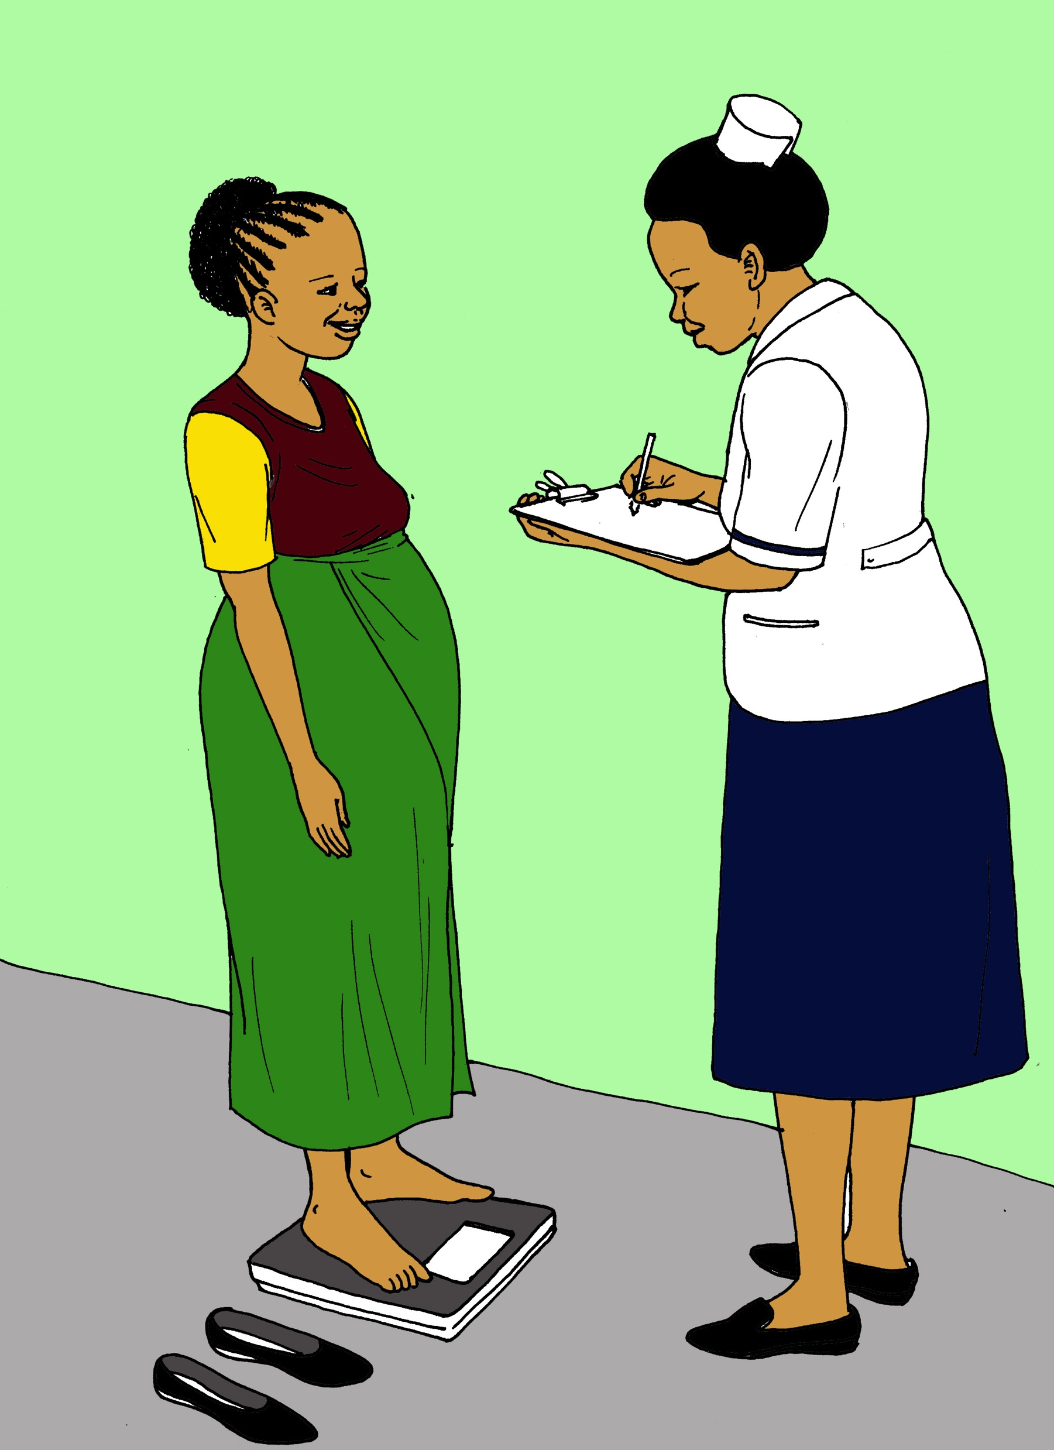
Factors that DECREASE risk of preterm delivery
Iron supplementation
Good nutrition
Prenatal care

Slide 12

Iron supplementation
Iron-deficiency anemia is a decrease in the number of red blood cells in the body due to a lack of iron
Iron-deficiency anemia is associated with an increase in the risk of preterm delivery
Women who take iron supplements during pregnancy are less likely to experience preterm labor

Slide 13

Good Nutrition
Women who eat too little or do not eat the right foods have an increased risk of preterm delivery
Pregnant women should have balanced diets with foods from all six of food groups: staples, fats, animals, legumes, vegetables, and fruits

Slide 14


antenatal care
Receiving regular antenatal care can help identify if you are at risk for preterm labor
If you are at risk of preterm labor, you will need to have more frequent antenatal care visits

Slide 15
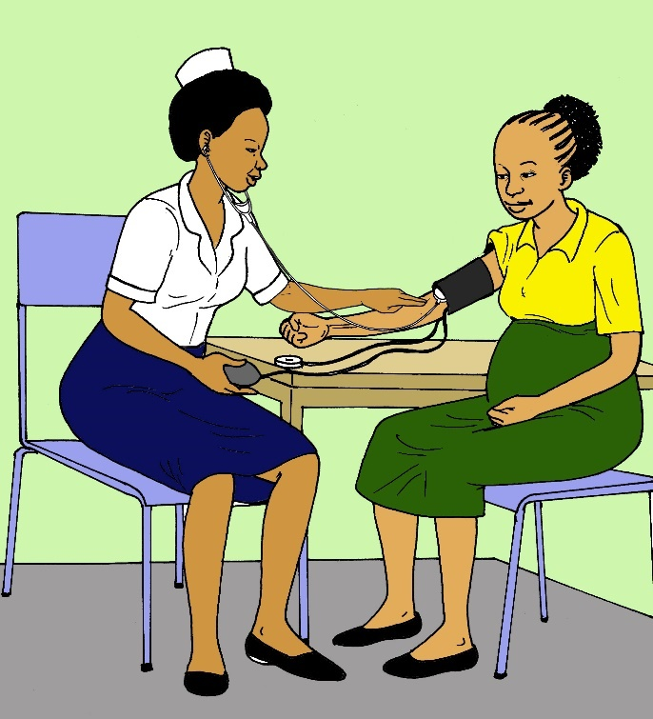
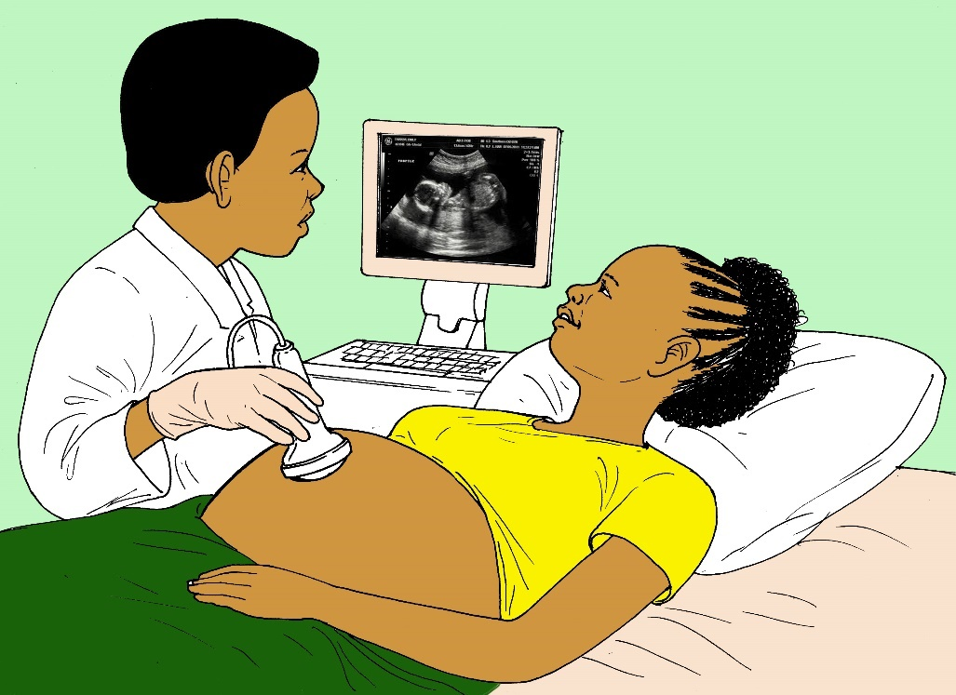
Antenatal care
If you are at risk for preterm delivery, you may need special testing

Slide 16


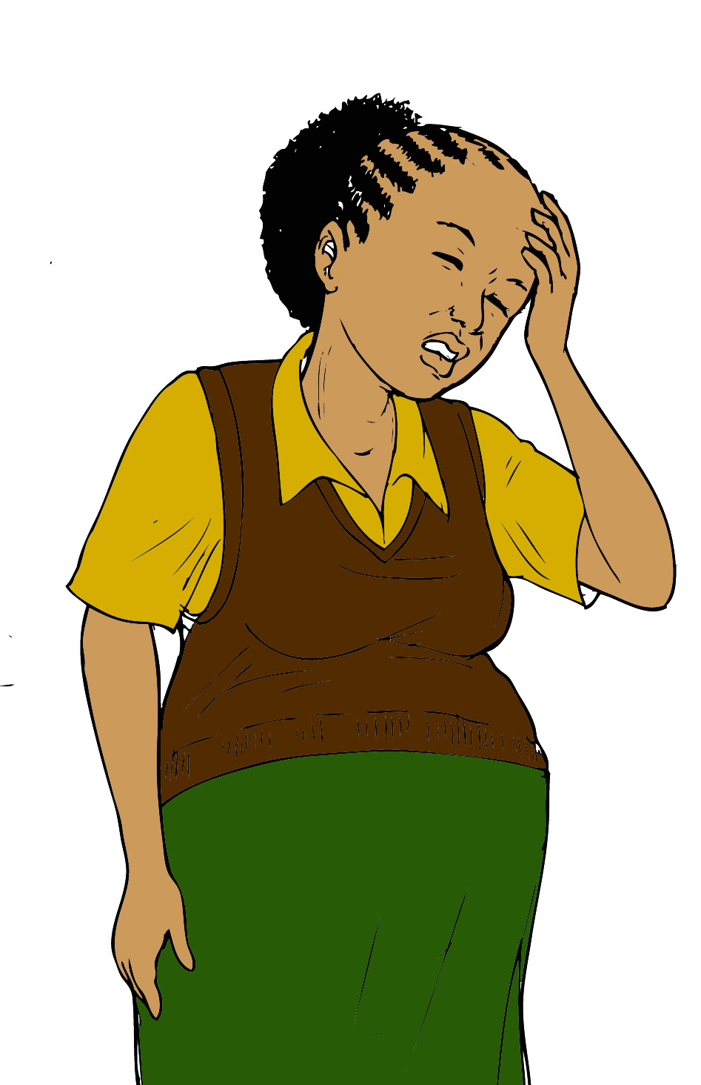

SIGNS of preterm labor
Abdominal cramping
Flu-like symptoms
Vaginal bleeding
Leaking of fluid

Slide 17

Abdominal cramping
The signs of preterm labor are similar to the signs of labor at the end of a normal pregnancy
If you have preterm labor, you may experience cramping in your abdomen or back
This might feel like menstrual cramps

Slide 18
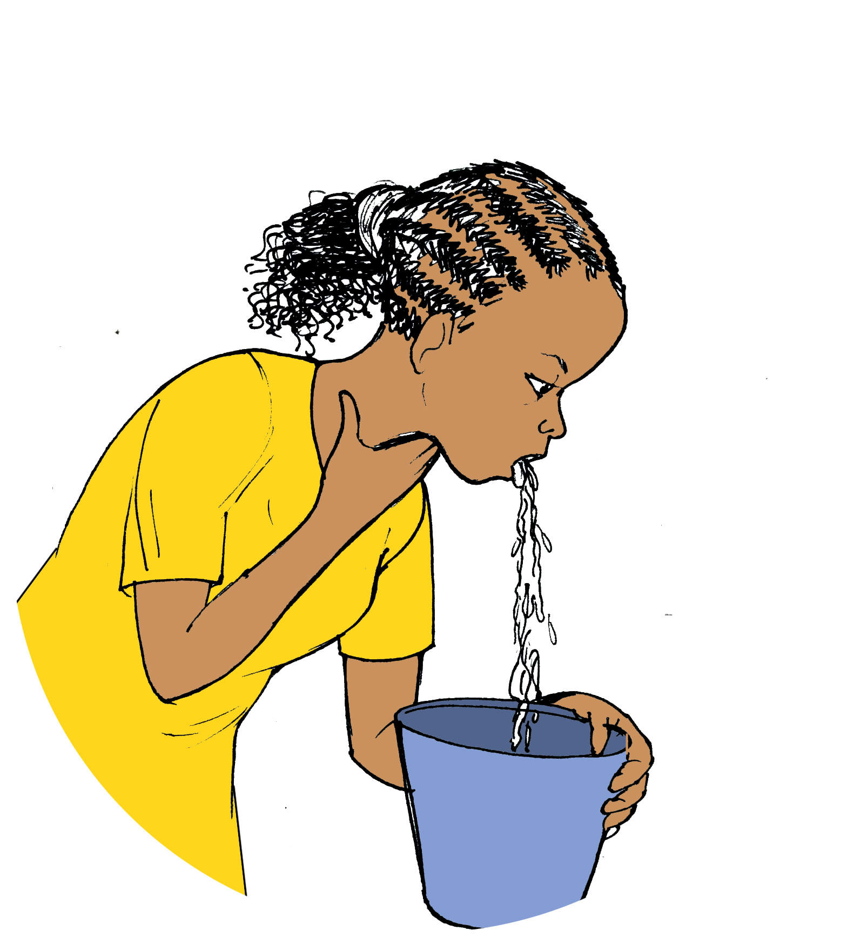

Flu-like symptoms
Fever, chills, fatigue, body ache, nausea, vomiting, and diarrhea can be signs of preterm labor
If you feel these symptoms along with cramping/contractions, you are at high risk for preterm delivery

Slide 19
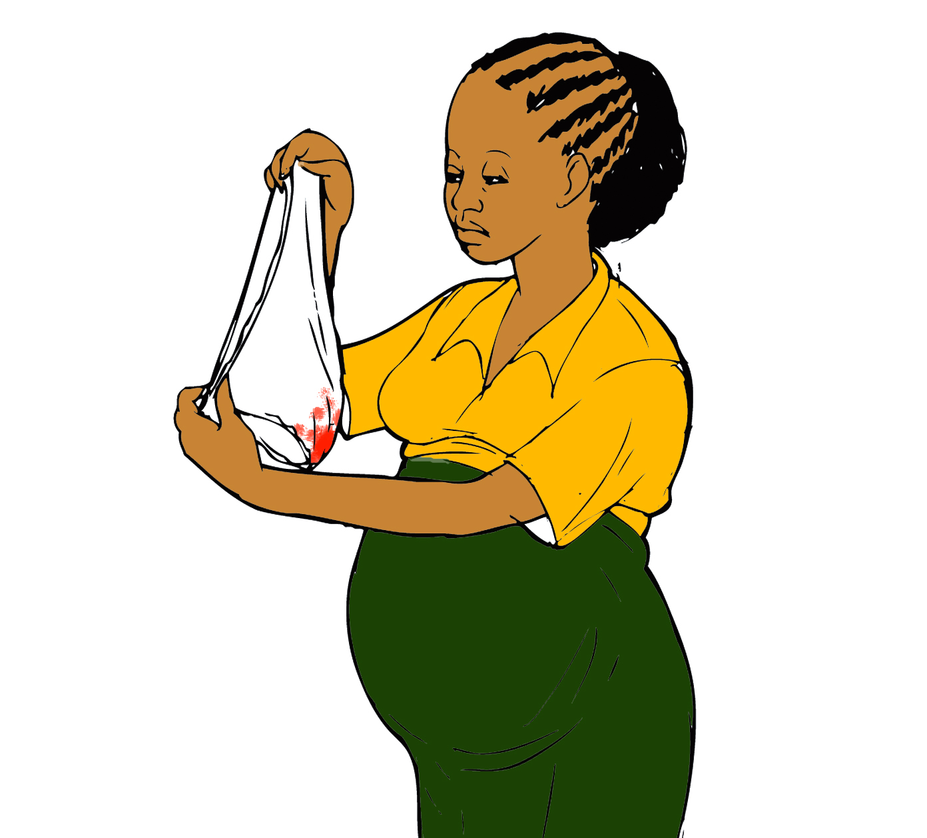
Vaginal bleeding
Vaginal bleeding or spotting early in the pregnancy is associated with an increased risk of preterm labor
If the bleeding happens multiple times or on multiple days, this might be a sign of preterm labor

Slide 20

Leaking of fluid
Amniotic fluid is the water surrounding the baby
When your “water breaks,” amniotic fluid leaks from the vagina, either quickly and in large amounts or slowly and in small amounts
Early leaking of amniotic fluid is a sign of preterm labor

Slide 21
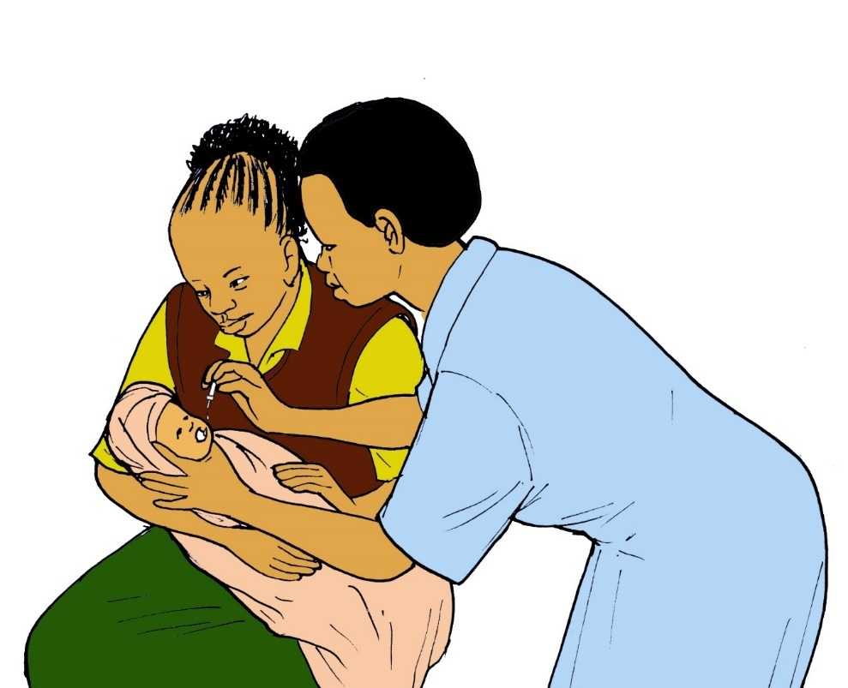
What to expect in the event of preterm delivery
Traveling to the clinic
Having a C-section
After Delivery
Hospital Care for Baby
Kangaroo Care

Slide 22
Traveling to the clinic
If you are experiencing signs of preterm delivery, you should travel to the nearest health facility immediately
You will be admitted to a hospital for close monitoring, and you might receive medications to stop labor

Slide 23
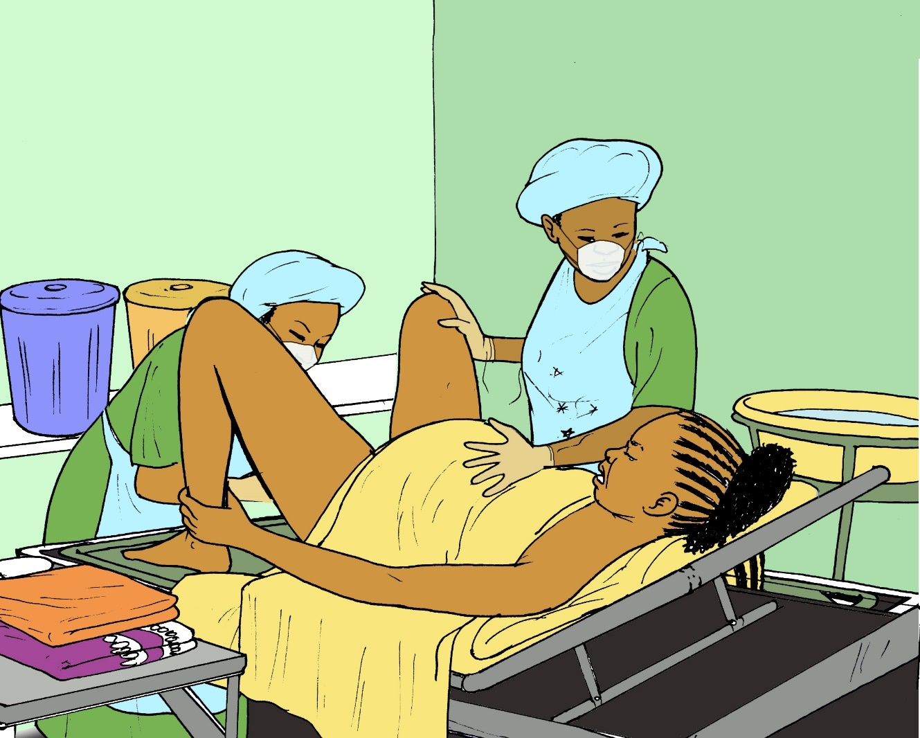
What will happen at the health centre?
If your labor cannot be stopped, you will need to deliver
If your baby is preterm, it is best that you are delivered by a skilled birth attendant in a health facility

Slide 24
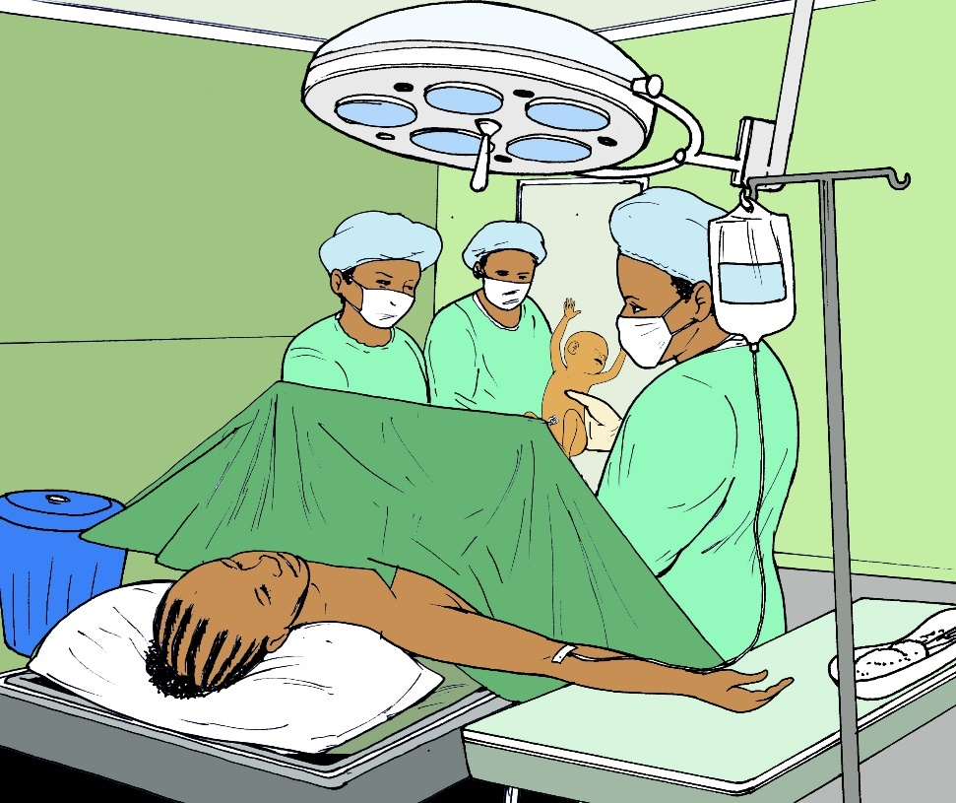
Having a Caesar
When you arrive at the health facility, you might need to receive a Caesar
Caesars are performed in the operating theater
During a Caesar, the surgeon will deliver the baby through an incision in the abdomen
Women who have infections, problems with the placenta, or chronic health conditions such as diabetes are more likely to need a Caesar

Slide 25
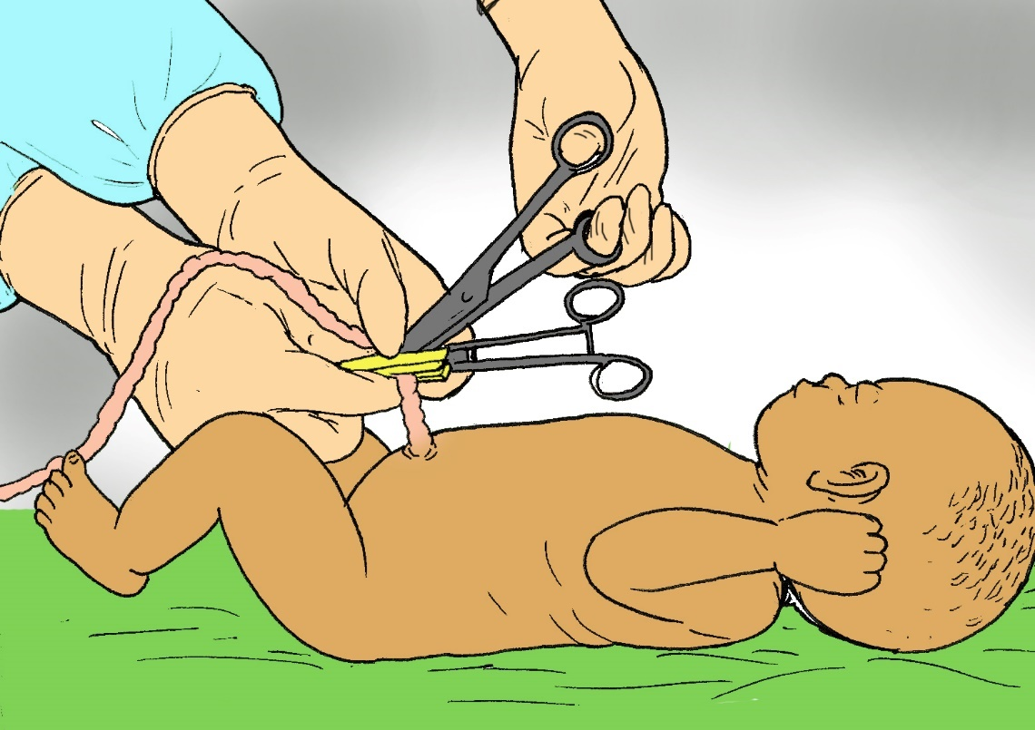
After delivery
The umbilical cord runs from an opening in the baby’s stomach to the placenta
Once the baby is born, there is no need for this connection anymore
After a birth, the umbilical cord should be clamped or tied and cut with a clean instrument to avoid infection

Slide 26
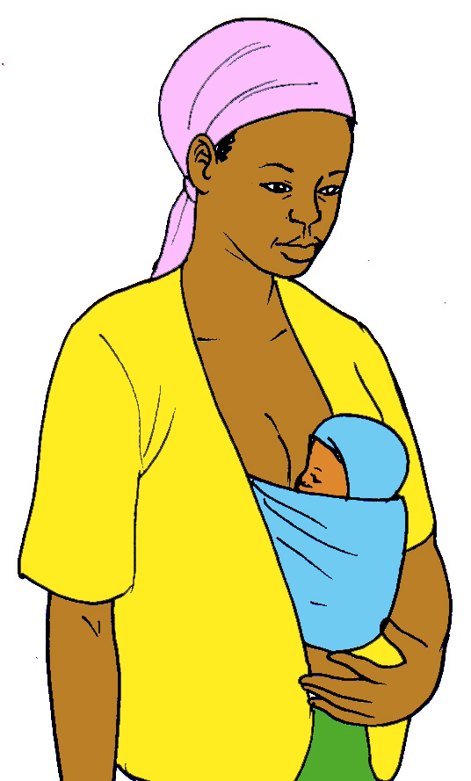
Kangaroo care
It is very important that the baby is kept warm after delivery.
To do this, you should put the baby on your chest directly on your skin and wrap a blanket or a chitenje around the baby.

Slide 27
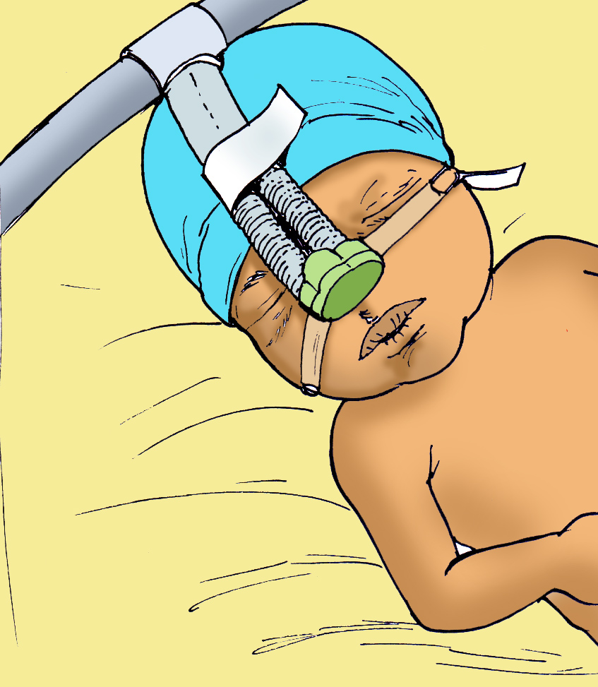
HOSPITAL CARE FOR BABY
Preterm babies are sometimes sick and require help with breathing
The baby may need to stay in the hospital for special care

Slide 28
How do I prevent preterm delivery in future pregnancies?
Pregnancy Spacing
Prevent or Treat Infection
Contraception

Slide 29


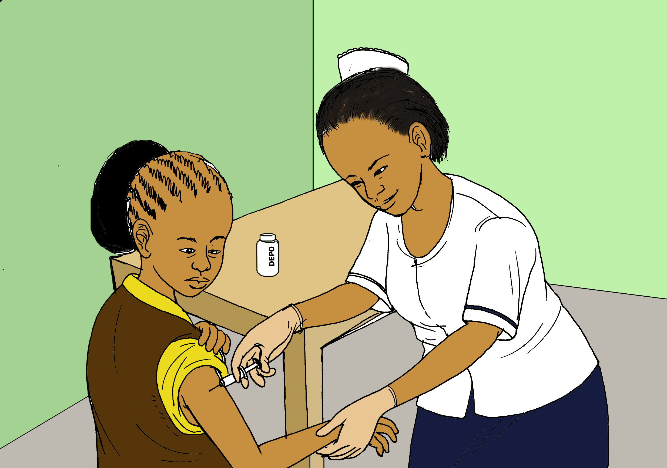
PREGNANCY SPACING
Waiting at least 2 years between pregnancies will decrease the chance of preterm labor
If you are sexually active, it is best to use contraception to prevent pregnancy and condoms to prevent infection
Implant
Birth Control Pills
Injectable Hormones

Slide 30
PREVENT INFECTION
Infection in any part of the body increases the risk of preterm birth
It is important to prevent infection and to treat any infection that you already have
When the mom is HIV+, preterm babies are more likely to be born with HIV than full term babies
It is important to continue taking your medications for HIV or any other infection throughout pregnancy

Slide 31




Acknowledgments
©2018 Baylor College of Medicine Abbott Fund Children’s Clinical Centre of Excellence Malawi, Lilongwe, Malawi
Illustrator: Rogers Chilemba
Creator:
Susan Raine, MD, JD, LLM, MEd
Jane Morris, MD
Contributors/Translators:
Deborah Nanthuru
Abiba Matengula
A special thanks to our patients for their valuable input

